Slide 1

SECURE HOME GATEWAY PROJECT
CIRA Labs
Secure Home Gateway
Project Update
Jacques Latour
March 2019
Notes:
Consider starting with a story of your vision – how did this come to be?

Slide 2




Project Evolution – From Idea in late 2016
In the home
Gateway
Need security access controls
Has to be easy to use
MIRAI Dyn Attack
October 2016
x
x
?
Need a new framework to prevent lightbulbs from killing the internet!

Slide 3
The many problems of today’s Home Gateway
No Standard Home Network Security Framework
No outbound traffic security controls
No standard onboarding process
Not globally reachable (no domain name)
Home
Gateway
No visibility on network activities
No unique WIFI keys per home device
No device quarantining processes

Slide 4




IoT Device Security Landscape
Many are Vulnerable
Software is out of date
Cloud architecture dependencies
Full access to the ENTIRE Internet
Some are Unsupported
Time to market -
Not to build correctly
Many standards being developed
Lack of secure testing and design
Require active monitoring
Contribute to DDoS attacks
Steal private information
Steal WIFI credentials
Send spam
Compromise your network
Record video and voice
Distribute malware

Slide 5





IoT vendors are creating dependency on cloud architecture
IoT Cloud
Services
IPv6 with CIRA delegated names for the home makes this possible
Personal information is of great value to vendors
On the road
At home
Direct is better

Slide 6
We put a team together to work on the idea
CIRA Labs
TwelveDot
SIDN Labs
Sandelman Software
Viagénie
Secure Home Gateway
Project
TELUS
/ Algonquin College
Canadian Multistakeholder
Process: Enhancing IoT security
iotsecurity2018.ca

Slide 7
Project Evolution – To a Secure Home Gateway (SHG) Prototype
openWRT
Turris Omnia
CZNIC
MUD Server Repository / Curation
SHG MUD Controller
Supervisor
SHG App “Ease of Use”
SIDN (.NL) SPIN
SHG Security Access Controls
Running
Code
Proposed
Standards
prpl Foundation
(prplWrt)
Secure
Home
Gateway
CIRA
DNS & SHG Provisioning
Mozilla IoT -
Web Thing API
Secure Home Gateway Framework
Standards Development
IETF, CSA/UL, ISO/IEC
Enhanced WIFI security
In progress:
DOTS, DNSSEC, Domain aware NFtable

Slide 8
Let’s look at the solution we have so far

Slide 9




Secure Home Gateway (SHG) Goals
x
Protect the internet from IoT devices attacks
x
Protect IoT devices from the internet attacks
Notes:
The primary goal of this project is to develop a secure home gateway that;
protects the internet from IoT devices attacks and
protects home IoT devices from the internet attacks

Slide 10



Current state of Home Gateways
Devices and current home gateways are not secure by default
Users typically lack the technical know-how to configure the devices. These technologies and their configurations are typically technically complex which results in many using default configurations or users making mistakes when configuring them.
Users don’t know who to contact when there is a security issue either with their devices or network.

Slide 11



Scope of work
Develop functional prototype
Open source code
Framework to provision SHG
domain names
Simple management interface
Enhance small network privacy & security
New standards requirements
Notes:
We are developing an advanced security framework for small network (home and small business) gateways based on integrating existing and emerging technologies & standards
Goals:
Develop a functional SHG prototype
Develop a simple management interface to provision complex network
Identify new standards requirements and updates
To enhance small network privacy & security with ‘intent based’ network access controls
To have open source running code & standards
Develop a framework to provision SHG domain names

Slide 12








Best practices – Apply enterprise security framework to home networks
Home Security
PDAP
Appliances
PDAP
IoT Cloud
Services
Sensors
PDAP
Management
Application
PDAP: Per Device Access Policy
Scale Enterprise solutions to fit the home network
Notes:
-> best practices and new standards (note to Jacques – please explain Per Device Access Policy (PDAP) for those who may not understand what it means)
Rule #1: Identify IoT devices on your home network
Rule #2: Place a policy around the IoT device that restricts it to a specific function (default is no access)
Rule #3: Monitor for behavioural changes in the device and quarantine at the first sign of change.

Slide 13

New standards – MUD - Manufacturer Usage Description – RFC8520
I’m an ACME water sensor
- MUD File at: https://acme.corp/mud/ws1.0.json
MUD FILE:
- I have WIFI & apply the water sensor access policy
- I need to upgrade my firmware at https://acme.corp
- Configure me at https://myip/setup
- Alerts available at https://myip/alerts
It would be nice if the IoT device could advertise it’s current firmware version and/or current MUD file URL via WIFI or network connection (DPP, DHCP, LLDP…) on order to setup correct security profile

Slide 14







SHG
ACME.CORP
MUD
Repository
(1)
CIRA SHG
MUD Repository
MUD Supervisor
(3)
User accepts
provisioning
instructions
(2)
Send to
CIRA
(2)
Get vendor
MUD file
SHG
App
MUD Controller
(IP Tables)
(4)
IoT device added to network with specific network access controls
Network Access control:
Allow access to ACME.CORP
Allow to send alerts internally
Allow to be configured by app
Deny all other internet access
(1)
(4)
(1)
Scan MUD
QR code &
send to MUD
Controller
(DHCP in future)
MUD QR Code
ACME.CORP
IoT Water Sensor
Notes:
High Level MUD & IoT Device Provisioning Workflow

Slide 15
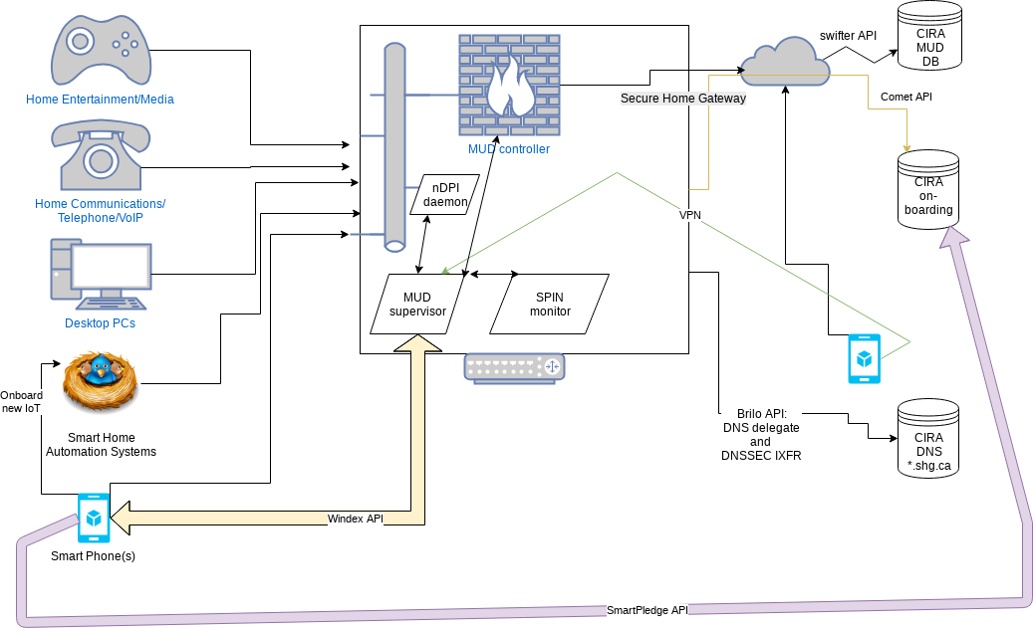
Work in progress architecture

Slide 16

That’s why we need a simple provisioning interface – this stuff is complex!!

Slide 17
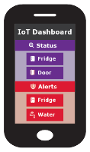
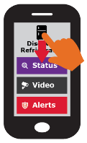
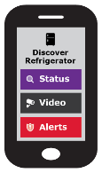



Removing end-user complexity
A simple user interface
Notes:
Simple user interface
The previous slides have outlined the high level workflow. The actual workflow and automation can be very complex.
One key goal of this project is to present the users with very simple choices to provision and administer a potential complex network.
Ideally, the user can only swipe up, down, left and right.

Slide 18





Quarantine of compromised devices -> Behavioural analysis
A standard process to quarantine and restore IoT Devices
https://datatracker.ietf.org/doc/draft-richardson-shg-un-quarantine
Manufacturer Usuage Description for quarantined access to firmware
https://datatracker.ietf.org/doc/draft-richardson-shg-mud-quarantined-access/
x
Appliances
Management
Application
The refrigerator is quarantined
- Bad lettuce ☺

Slide 19
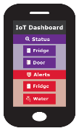



Secure remote access: Trusted authentication & accessible
The prototype will use securehomegateway.ca 3rd level domains
Mobile
n3CE618.router.securehomegateway.ca
22
Notes:
Removing the complication surrounding enabling trusted secure remote access to home network is a key goal of this project (not for the initial prototype)
Need an internet resolvable domain name for the SHG to remotely connect. i.e. “myhome.ca”

Slide 20

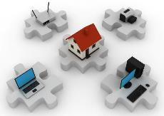
Automation
Secure gateway
provisioning automation
Secure device
provisioning automation
+
INNOVATION
Notes:
The focus is on automation

Slide 21



Step 1 – bundle with a DNSSEC signed 3rd or 4th level .CA domain
+
+
QR Code to activate provisioning and domain
3rd level domain
domain.securehomegateway.ca
4th level domain
domain.router.securehomegateway.ca
Notes:
When you buy a CIRA secure home gateway, it comes bundled with a DNSSEC signed 3rd level .CA domain.

Slide 22


Step 2 – Secure Home Gateway setup
BRSKI enrollment of with disconnected Registrars – smarkaklink
This document details the mechanism used for initial enrollment using a smartphone of a BRSKI Registrar system.
…where the registrar device is new out of the box and is the intended gateway to the Internet (such as a home gateway),
but has not yet been configured…
SHG
application
kaklink ☺
https://datatracker.ietf.org/doc/draft-richardson-anima-smarkaklink/
Notes:
Follow the configuration instructions
Install & open the CIRA SHG App
Power on the SHG
Scan the SHG QR code for initial setup
System Assigned 3rd level domain name
Setup split view Internet/External DNS for SHG domain
Home Gateway ready for configuration

Slide 23


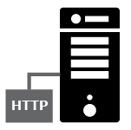

Step 3 – External DNS/DNSSEC Provisioning
Internal
DNS view
Secondary DNS
D-Zone
SHG External
IP Address
SHG External
Domain Provisioning
& Primary DNS
External
DNS view
Hidden Primary
Notes:
Automated DNS Backend Provisioning @ CIRA
CIRA creates the 3rd level .CA SHG domain w/DNSSEC
SHG and CIRA sync on external view propagation, internal SHG DS record synced in external DNS view. (full chain of trust internally and external on SHG domain)
Need synchronisation between external SHG DNS record and SHG external IP address

Slide 24



Step 4 – Automated Wi-Fi setup
MUD profile
Wi-Fi credentials
Device access policy
Scan
Notes:
Current focus is on automated Wi-Fi setup – that’s challenging!
Setup secure home network infrastructure
Using your SHG App, scan the QR code of each new device to:
Discover the MUD profile
Transfer the unique WIFI credentials (per MAC address)
Assign the appropriate Device Access Policy

Slide 25
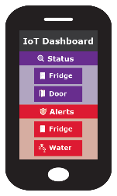
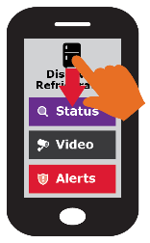
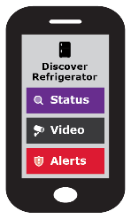
Simple user interface is key to this project
Swipe UP, DOWN, LEFT and RIGHT
Notes:
Gateway provisioning, device discovery, device provisioning must be as simple as possible, intuitive for non experienced users, available as framework for default open source app.

Slide 26

Roadmap: Future functionality
Notes:
Next slides include things we identified for potential future work or functionality
Includes ideas, comments & feedback

Slide 27








IoT service / action type – Generic IoT home controller
Notes:
Status: Up/down, on/off, ok/bad, status variable
Audio/Video: Camera, video feed
Media: Audio/Video media feed, TV, music
Storage: Data storage, NAS (pictures, files, data)
Alerts: Up/down, on/off, ok/bad, “Water detected”
Control: Turn up/down, on/off, change device value
Cloud Service: IoT vendor, Google, MS, DropBox
VPN (VPN inside vpn.myhouse.ca)
Remote house access
Quarantine, New MUD profile available
Other Sensors/ Actuator functions?

Slide 28
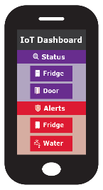


Adding remote VPN access to trusted mobile and computers
(2) Grant permission and credentials to mobile for remote home access
Mobile
(1) Discovery services
31
28

Slide 29
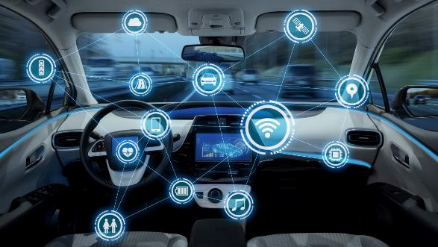
Should the inside of your car be part of your home network as well?
29

Slide 30





Adding your car
Car
(2) Assign roles
Control car feature
View car alerts
(1) Discovery services
View car status/location
32
30
Notes:
Adding your Car to remotely access your home network

Slide 31


There are many more IoT scenarios to be assessed!
Notes:
List of IoT scenarios to be assessed
Example of pushing WIFI to the device
Show that the fridge is exposing service
No web interface on IoT device
Focus on cloud / vendor, show they integrate into this solution, can be multi vendor multi cloud provides
IoT Classification: based on device type, air play could see all camera in the house, the TV could see all camera (security controls)
Door bell sends to audio device, you car
Fire alert send to audio receiving device
SmartGRID company allow access to home gateway
allow SmartGRID to access hot water tank
allow SmartGRID to adjust thermostats

Slide 32
This slide deck is a vision
it’s what we’ll be seeing in five years.
Notes:
Is work in progress, presented as a story
Story how a home gateway can be user and IoT friendly
Is meant to define a security framework and associated standards
IETF, ISO/IEC, others..
Is tuned around implementation at .CA / CIRA, but not specific just for CIRA
Is to solicit feedback
Is another layer of defence (in depth) to protect the internet against nasty (IoT) devices

Slide 33
Want more info?
Visit the CIRA Labs page and as well as GitHub
https://cira.ca/cira-secure-home-gateway
https://github.com/CIRALabs
Don’t forget to share your feedback and input!
Notes:
For an informational version of this deck that includes:
High level architecture graphic
More details on the proof of concept and prototype
Specifications we are currently leveraging

Slide 34
Questions?

Slide 35
Our assessment of the home network and IoT security posture post MIRAI attack clearly identified a need for additional home security measures to protect the internet from compromised IoT devices and a very strong need for an enhanced open source home security framework.
Our work so far has identified a significant gaps in open source projects to implement an enhanced home security framework
We embarked on a journey to identify these gaps and start development of many open source projects to better the internet ☺

Slide 36
Why are we working on this? -> Risk mitigation
For many internet organizations like CIRA the #1 risk on the risk register is a large scale (Dyn like) DDoS attack.
One of the mitigation mechanisms for this risk is to prevent ‘weaponization’ of IoT devices
Tightly controlling access ‘to’ and ‘from’ IoT devices inside the home or small office network is key to preventing ‘weaponization’ and causing harm on the internet.
The threat that IoT devices bring is the scale of attacks. The uncontrolled access of million/billions of IoT devices to and from the internet is the threat we need to mitigate.

Slide 37
Overview of the IoT threat landscape -> Scale and capacity
IoT device compromises:
Used in internet attacks i.e. MIRAI/DYN Attack (DDoS) targeting DNS servers (~1.2 Tbs)
IoT traffic generation, reflection and amplification
IoT device used various attacks (DDoS) NTP, DNS, SNMP and new vectors.
IoT device have the capacity to generate large traffic load
Home and small office network now starting to have gigabit internet access speed, significantly impacting the capacity to create powerful attacks

Slide 38






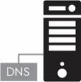






High Level Architecture (very ;-)
Home Network
OpenWrt
Home Gateway
Internal DNS/DNSSEC
External IPSEC
D-Zone firewall
Wifi MiFi Zigbee
NFC RFID
3rdlevel.securehomegateway.ca
Secure Remote Home Network Access
IoT Cloud
Services
&
D-Zone Firewall
CIRA SHG Registry
Primary DNS
D-Zone
3rd Level .CA home domain
Home Gateway
Provisioning

Slide 39
We are building a Prototype -> Based on Omnia Turris Gateway
Develop a Proof of Concept and prototype
Using .CZ Omnia Home Gateway & openWRT
IoT device provisioning based on MUD
Home Gateway App (Android/iPhone)
Develop some IoT discoverable devices and MUD profiles
Use public GitHub to document the functional specification and repo for prototype software
Functional specification (Work in progress)
Open source software repository
https://github.com/CIRALabs/Secure-IoT-Home-Gateway

Slide 40
Specifications we are currently leveraging
Specifications we are leveraging:
https://datatracker.ietf.org/doc/draft-ietf-opsawg-mud/
https://datatracker.ietf.org/doc/draft-ietf-netmod-acl-model
RFC 7368
RFC 8375
https://datatracker.ietf.org/doc/draft-ietf-homenet-simple-naming
https://datatracker.ietf.org/doc/draft-ietf-homenet-front-end-naming-delegation
RFC 4033,4034,4035 (DNSSEC)
https://datatracker.ietf.org/doc/rfc5011/
RFC 4795
Specifications we are planning/considering:
RFC4301, RFC7296 (IPsec. Considering OpenVPN too)
RFC8366, https://datatracker.ietf.org/doc/draft-ietf-anima-bootstrapping-keyinfra/
https://datatracker.ietf.org/doc/draft-cheshire-dnssd-roadmap/
https://datatracker.ietf.org/doc/draft-ietf-dnssd-hybrid/
https://datatracker.ietf.org/doc/draft-cheshire-dnssd-roadmap/
https://datatracker.ietf.org/doc/draft-ietf-dnssd-mdns-relay/
Specifications we are writing:
draft-richardson-anima-smarkaklink-00
draft-richardson-opsawg-securehomegateway-mud-01
draft-richardson-shg-mud-quarantined-access-00
draft-richardson-shg-mud-quarantined-access-00

